Slide 1
How to conduct an effective literature review
Joanna Thielen | Librarian for the ME dept. jethiele@umich.edu
MEGC Workshop
July 14, 2021
Notes:
PUT IN CHAT: Link to today’s slides https://docs.google.com/presentation/d/1KhTKUOCkOJXpe_ornDsy0T9ykv_aW2jfKizhnAhvP0E/edit?usp=sharing

Slide 2
Zoom overview
There no stupid, silly, or too basic questions about the UM Library.
I’m not grading or judging you. I’m here to help you succeed!
So please ask questions!
Use Chat for questions and comments throughout
Please keep mics muted ─ unmute during Q&A portion
Closed captions are available
This is being recorded

Slide 3
Outline for today’s workshop
Answers from the workshop registration form
Brief overview of U-M Library
Determine which type of literature review you need to do
Search scholarly databases effectively for literature
Brief overview of using a citation manager to keep your literature organized
Key takeaways and additional resources

Slide 4
Answers from the workshop registration form

Slide 5
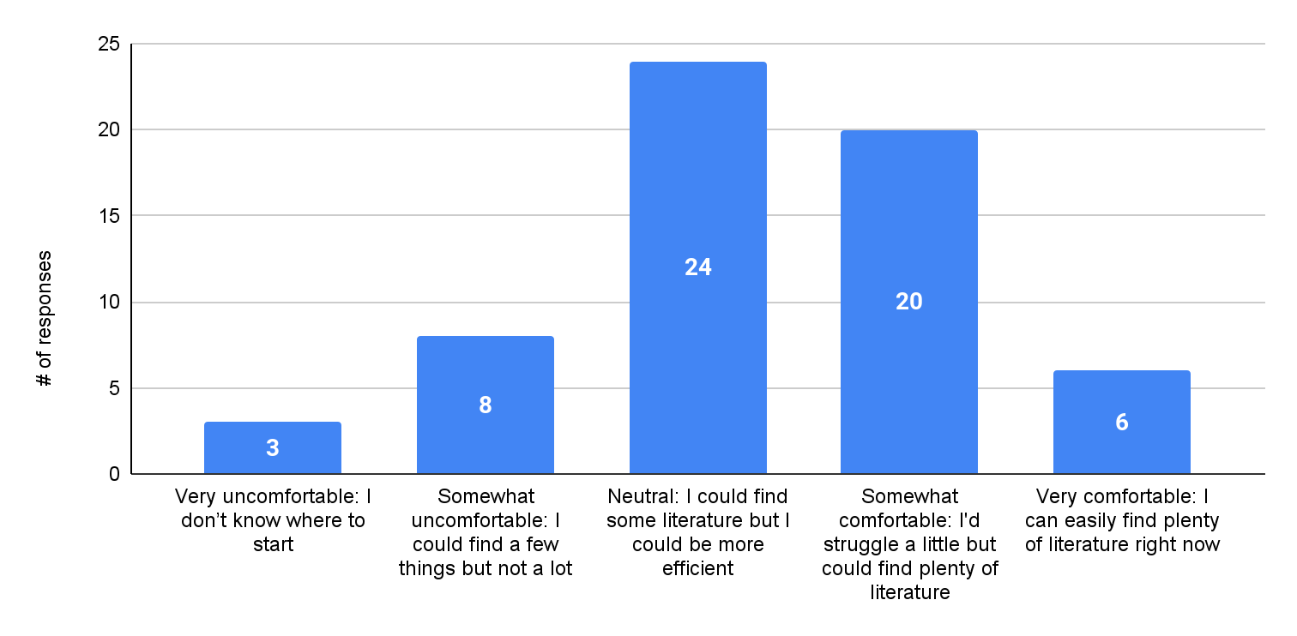
If your PI asked you today to find literature for a new research project, how comfortable are you doing so?

Slide 6
What’s the most difficult part of the literature review?
Unfamiliar terminology and concepts
How do I start?
Searching with the right keywords
Organizing my literature
There’s an overwhelming number of online resources, how do I know which to search?
How do I know when I’ve found enough?

Slide 7
There were lots of questions about
how to read journal articles.
We don’t have time to cover that topic today.
There will be another workshop on this topic during the Fall semester.

Slide 8
Overview of U-M Library
Everything shown today is free to use!

Slide 9
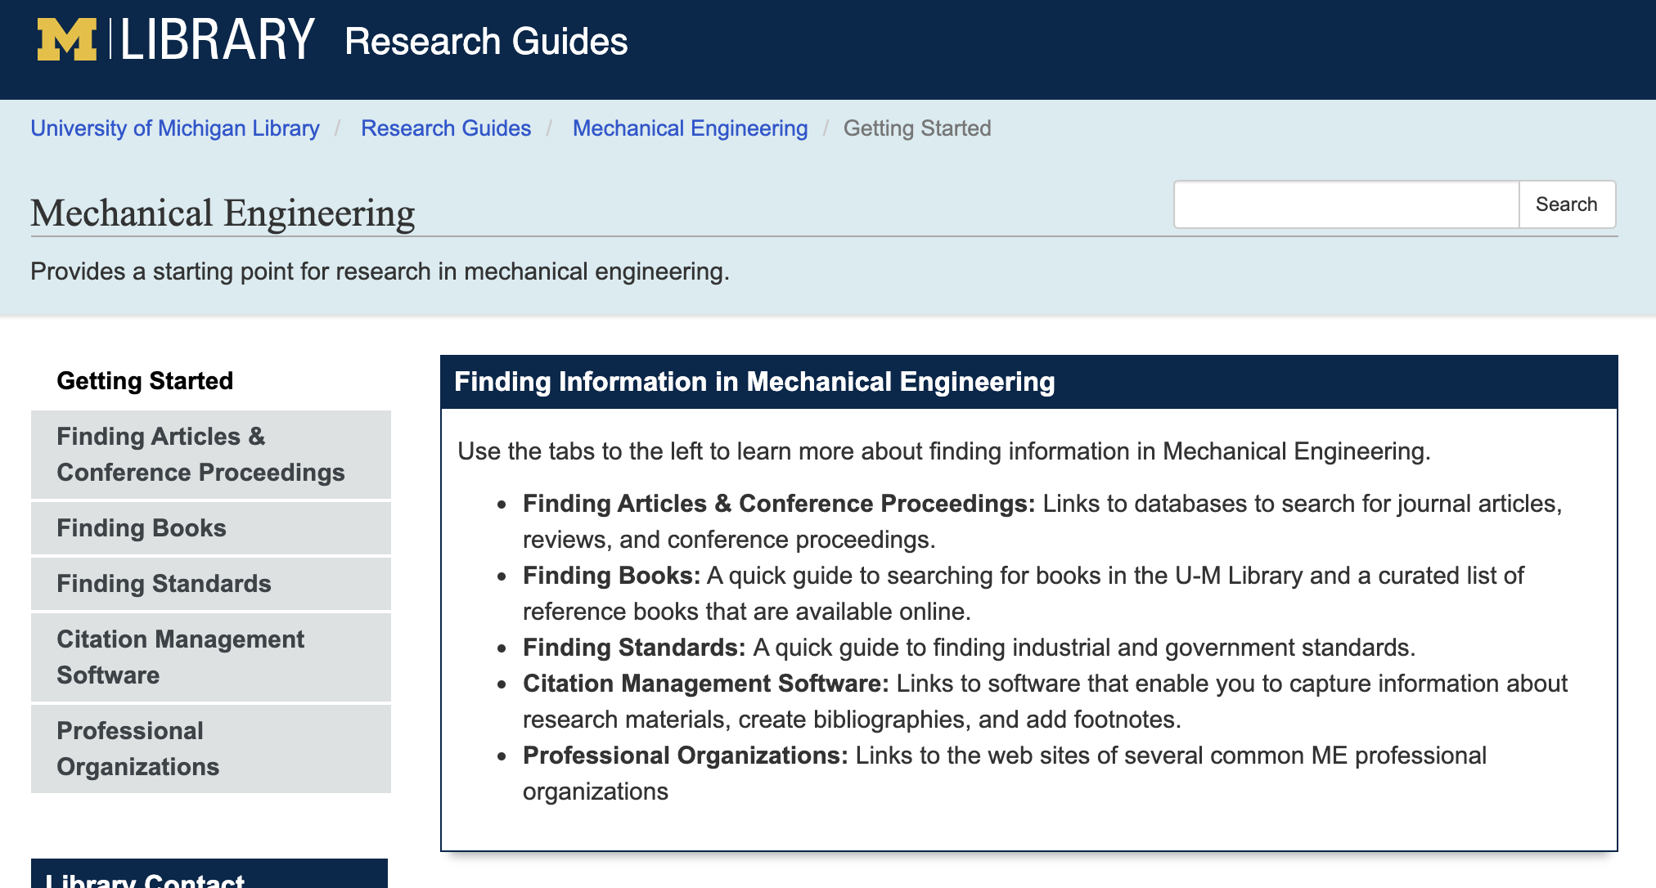
Mechanical Engineering research guide on U-M Library website (screenshot is clickable link)
Notes:
PUT IT CHAT: ME research guide https://guides.lib.umich.edu/mecheng

Slide 10
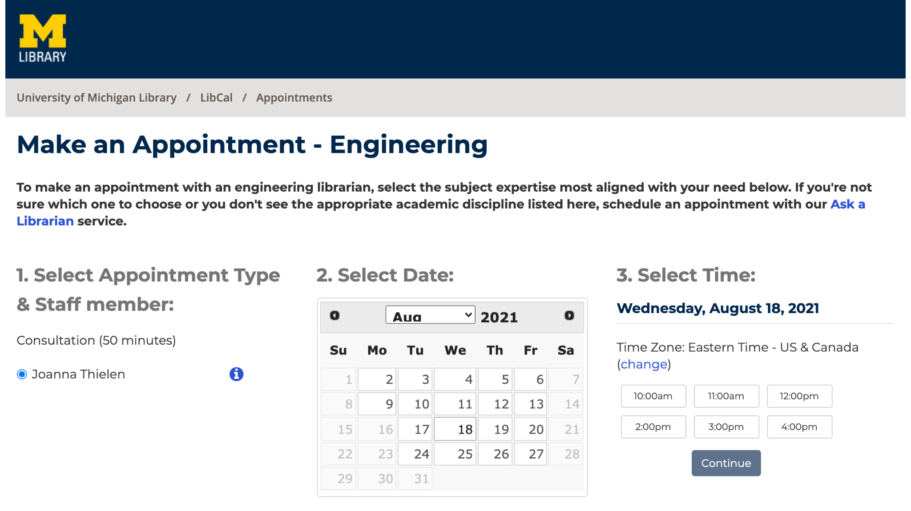
Schedule an appointment with Joanna: umich.libcal.com/appointments/jethiele
Notes:
PUT IT CHAT: Schedule an appointment with Joanna https://umich.libcal.com/appointments/jethiele

Slide 11
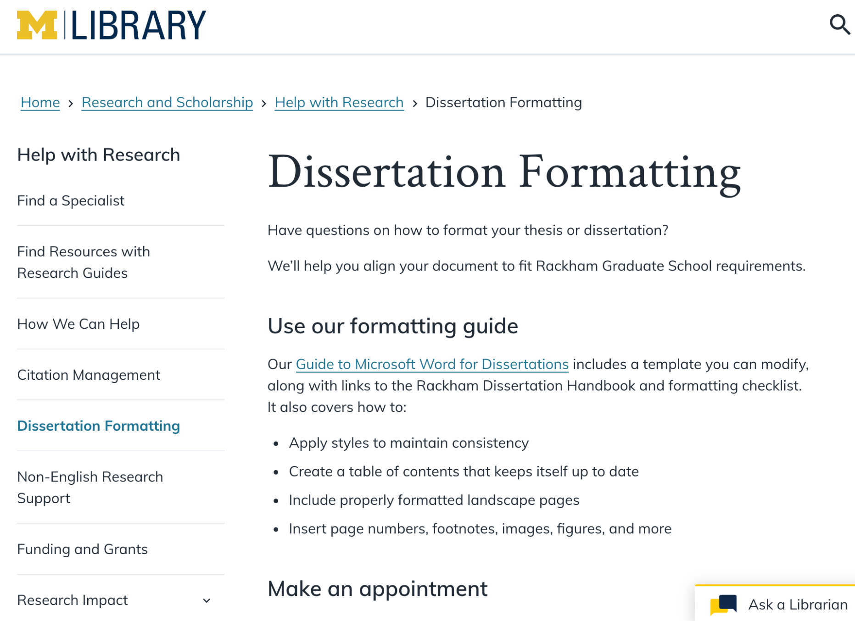
Dissertation formatting web page on U-M Library website
(screenshot is clickable link)
Notes:
PUT LINK IN CHAT: Dissertation formatting service at UM Library https://www.lib.umich.edu/research-and-scholarship/help-research/dissertation-formatting

Slide 12
Use UM Library’s free, online
Interlibrary Loan service
What if I’m looking for a book that UM Library doesn’t have?
What if I’m looking for an article that’s not online?

Slide 13
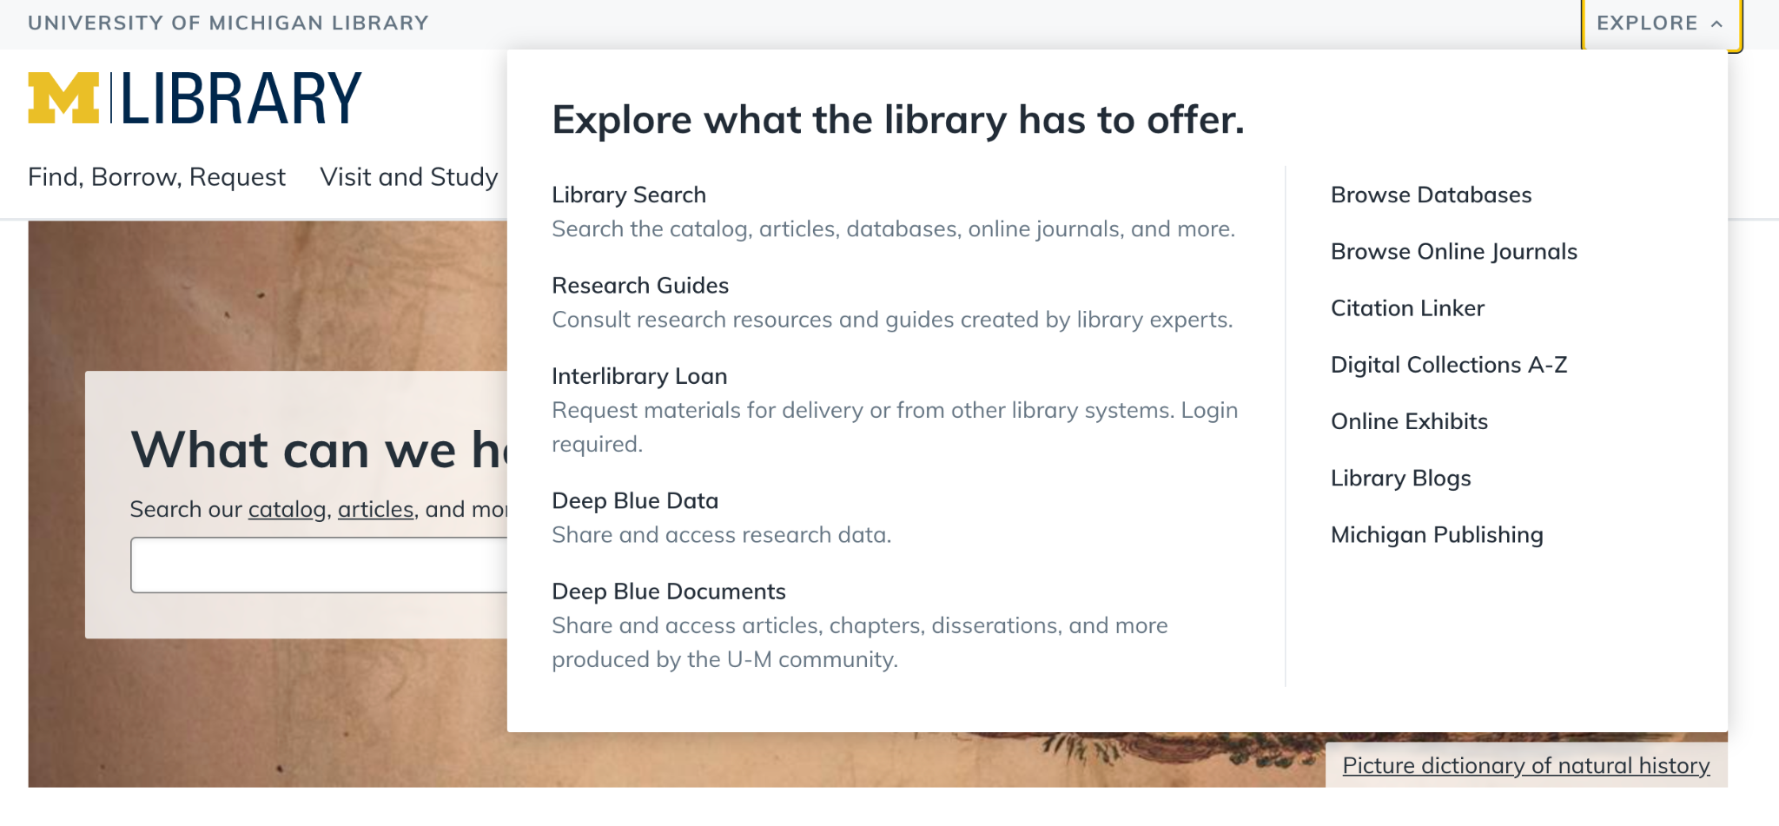
1
2
You can also request scans of portions of UM print books!
Access Interlibrary Loan/Document Delivery service from the UM Library homepage: lib.umich.edu

Slide 14
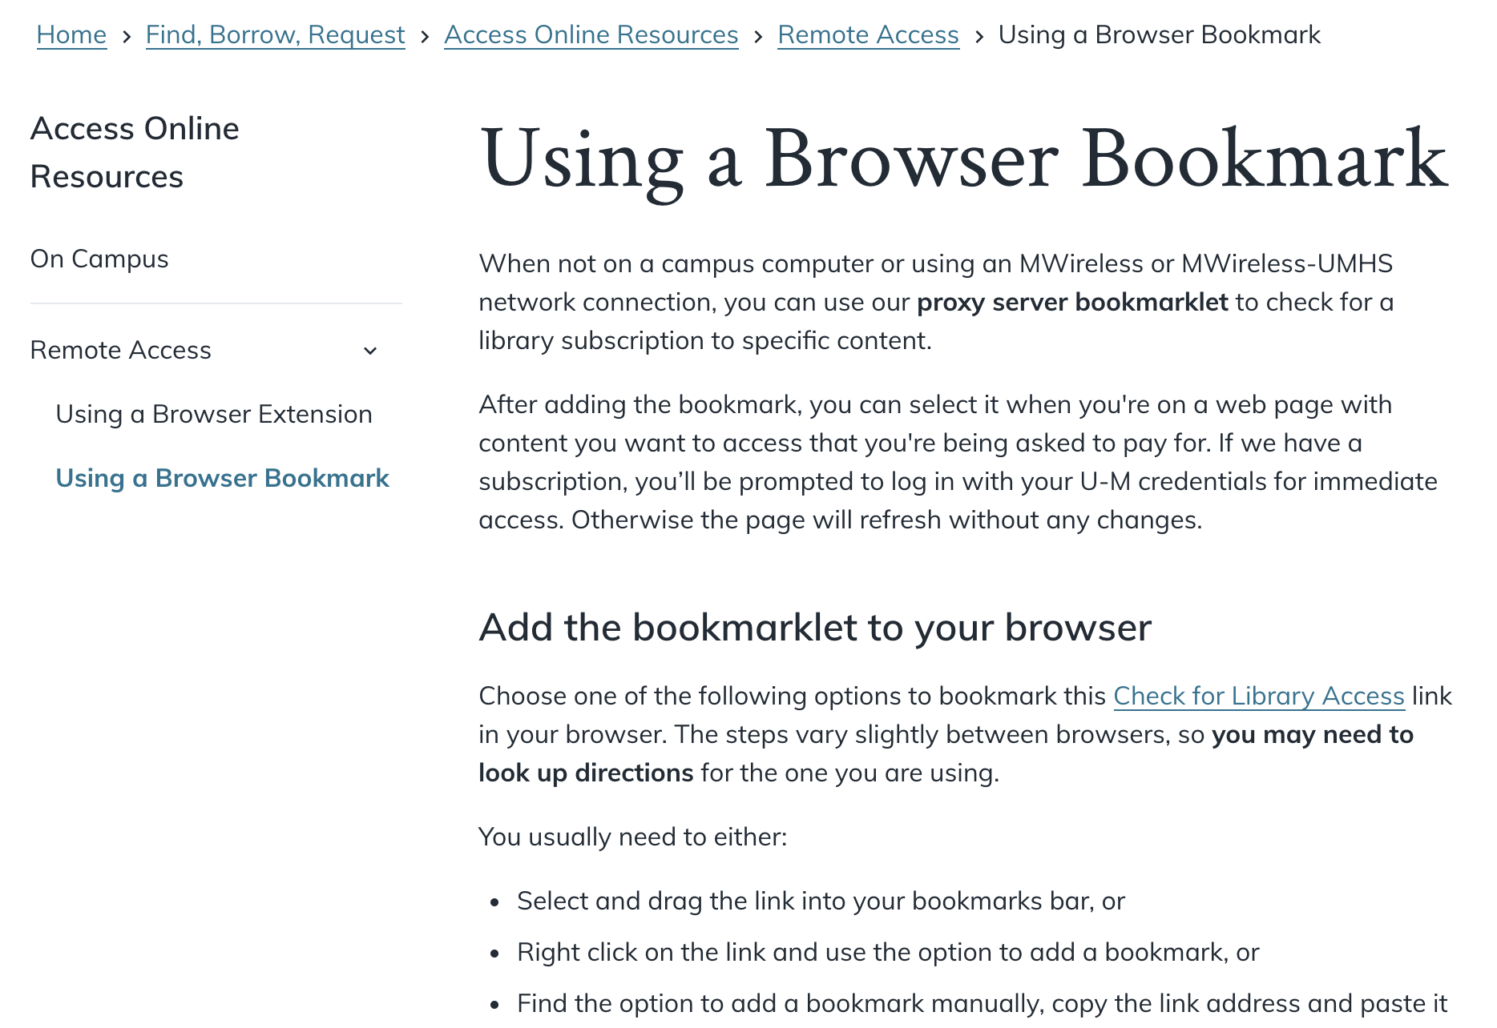
Proxy Server Bookmarklet
(Screenshot is clickable link)
Notes:
PUT LINK IN CHAT: Proxy server bookmarklet https://www.lib.umich.edu/find-borrow-request/access-online-resources/remote-access/using-browser-bookmark

Slide 15
What is a DOI?
Example DOI: 10.1016/j.eti.2020.101233
Digital Object Identifier
Always starts with ‘10.’
Think of it as document’s Social Security Number → it’s a unique ID
How to use DOI to get PDF of document
Copy/paste DOI into URL bar of web browser
On publisher’s website (if available online), look for PDF symbol/words
Note: May need to use Proxy Server Bookmarklet to get access to PDF
Notes:
DOI to demo: 10.1016/j.eti.2020.101233 (Roughness and wettability of biofilm carriers: A systematic review)

Slide 16

Which type of literature review do I need to do?

Slide 17
generate
keywords
Conducting a
Literature Review:
A Six-Step Process
write the
lit review
locate literature
synthesize literature
evaluate literature
organize literature
From: John Creswell “Educational Research,” 6th Edition, 2019

Slide 18
Part of a Larger Work
Intro to
Journal Article
Thesis / Dissertation
Selective
Comprehensive
Course
Assignment
Review Article
Stand-alone Work

Slide 19
Types of Literature Reviews
Grant & Booth (2009) found 14(!) different types of reviews found in the literature.
We’re not going to discuss them all.
Note: there is overlap between review types.
Literature review
Scoping review
Systematic review
Meta-analysis
Etc.
Grant & Booth (2009). A typology of reviews: an analysis of 14 review types and associated methodologies. Health Information and Libraries Journal, 26, 91–108. DOI: 10.1111/j.1471-1842.2009.00848.x

Slide 20
Literature Review
Often generically used to mean any type of review
More precise definition:
“Published materials that provide examination of recent or current literature. Can cover wide range of subjects at various levels of completeness and comprehensiveness. May include research findings”
Identifies gaps, explains importance of topic, hypothesizes future work, etc.
Usually written as part of a larger work (journal article, dissertation, etc.)

Slide 21
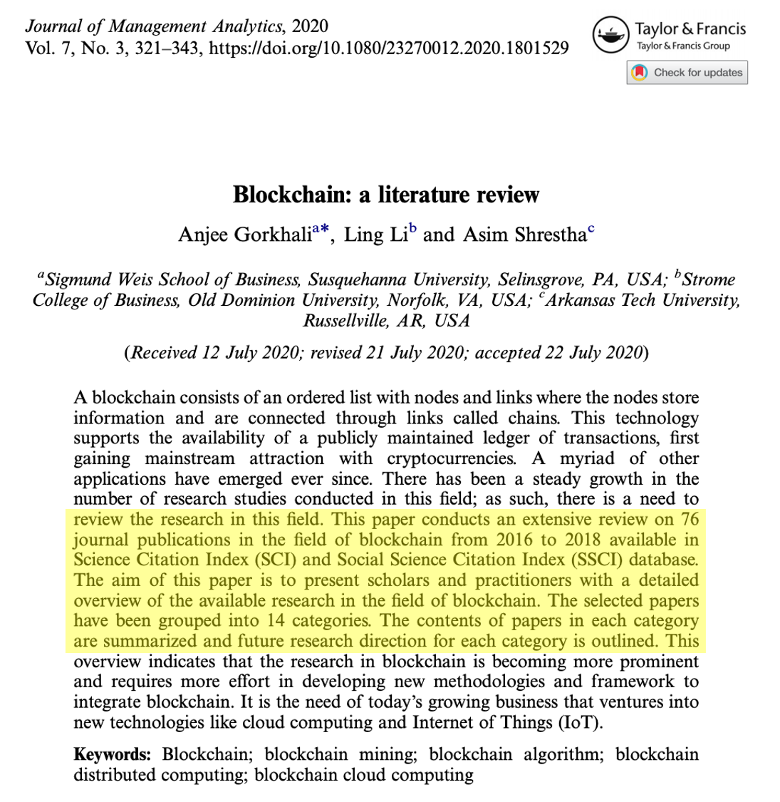
Example
Literature Review
(Screenshot is clickable)

Slide 22
Scoping Review
“Provides a preliminary assessment of the potential size and scope of available research literature. It aims to identify the nature and extent of research evidence (usually including ongoing research).”
Caveat: scoping reviews don’t assess quality of literature
Presence of literature on a topic shouldn’t be conflated w/ the quality of that literature

Slide 23
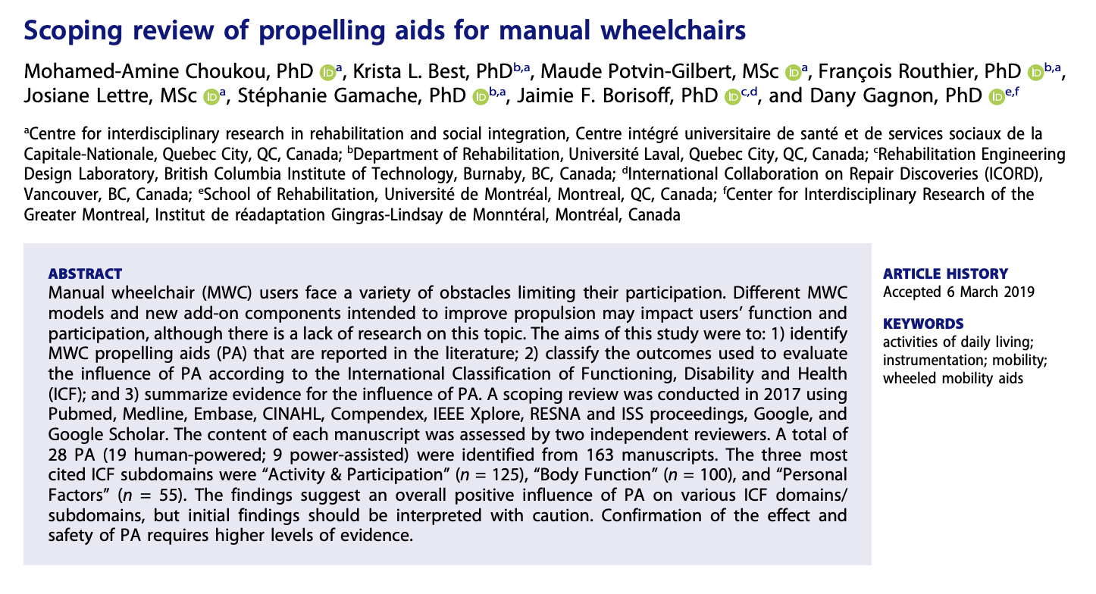
Example of a scoping review
(Screenshot is clickable)

Slide 24
Systematic Review
Common in the Health Sciences
Goal: gather all relevant literature transparently to answer a question then appraise its quality and synthesize it
Should follow strict protocol
Typically performed by research teams
Takes 12-18 months to complete
Literature needs to meet specific criteria (methodology, population, treatment, etc.)

Slide 25
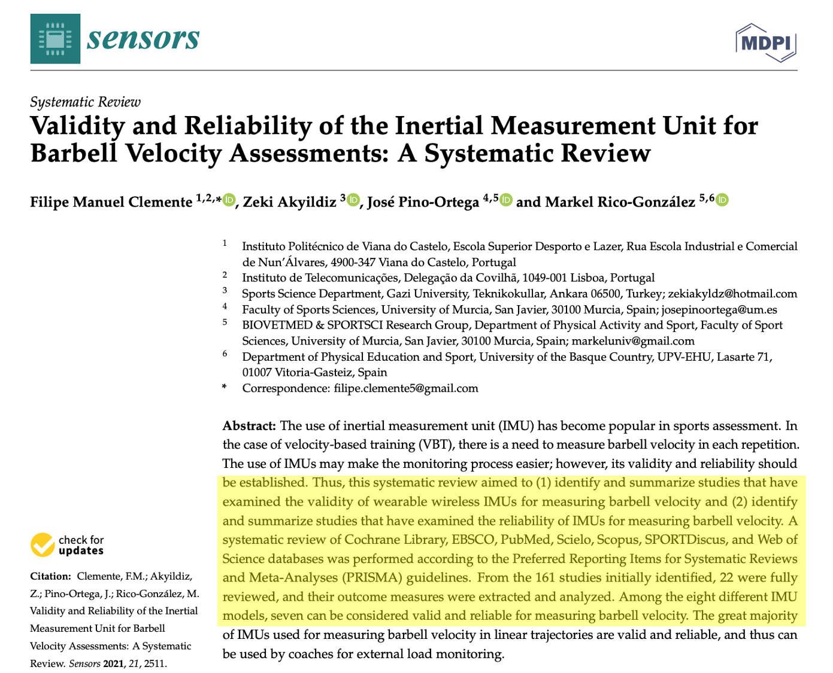
Example of a Systematic Review
-States research question(s)
-Follows protocol
-Appraises all lit gathered
-Synthesizes all included lit
(Screenshot is clickable)

Slide 26
Meta-Analysis
Goes one step further than a systematic review
After completing systematic review, a meta-analysis “statistically combines the results of quantitative studies to provide a more precise effect of the results.”

Slide 27
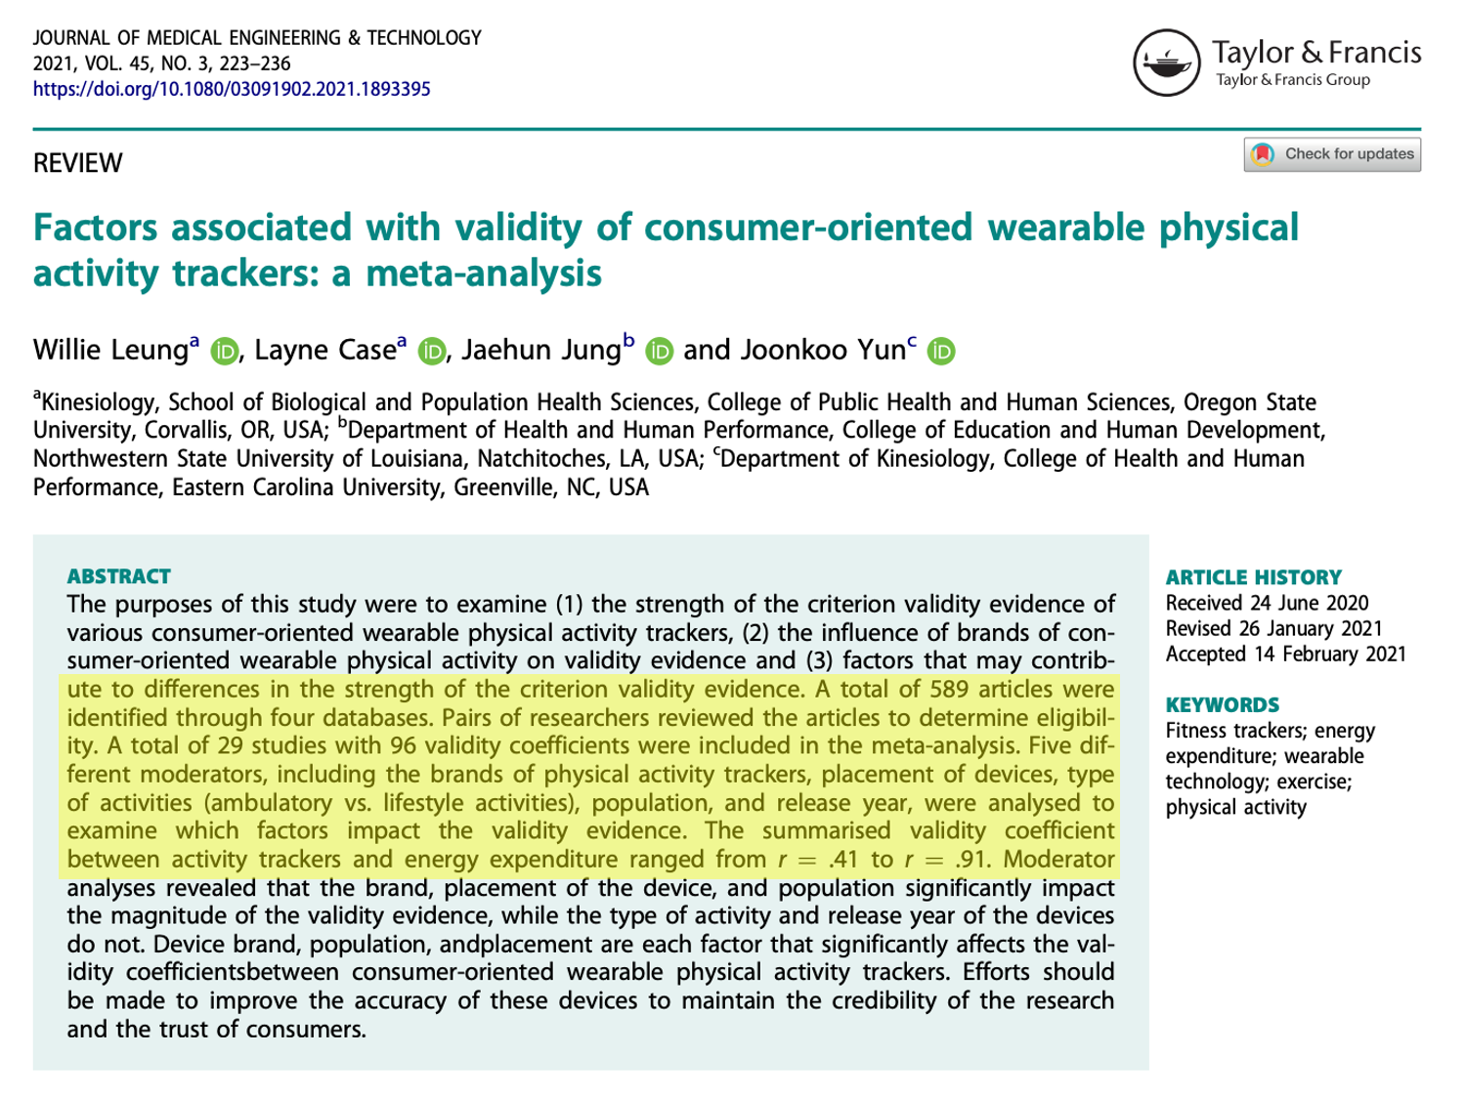
Example of a meta-analysis
Use these keywords in your own searches!
(Screenshot is clickable)

Slide 28
So what’s a Review Article?
Could be any type of review, depending on journal’s guidelines/focus
Look for clues in the title, abstract and methodology
Review articles are a great way to become familiar with a new topic!
Caveat: They summarizes the literature at a specific point in time → A review published in 2020 will differ from a review published in 2010

Slide 29

What else should I think about before starting my Literature Review?

Slide 30
How do I start looking for literature?
Read articles recently published by your lab group/collaborators
Find review articles on your topic
Talk to lab mates, mentors, PIs, journal club, etc. about key articles, authors, journals, etc.
Look up articles by those authors
Browse recent issues of those journals
Use Wikipedia
References section often has links to scholarly, peer-reviewed articles
Many articles list keywords on the 1st page → keep track of them!

Slide 31

How do I know when I’ve
found enough literature?
Only YOU can answer this question!
Things to consider:
It’s an art, not a science → the more you search, the more you’ll fine tune your ‘6th sense’ for the lit.
New literature is being published daily → you have to stop at some point
Avoid selection bias (i.e. you need to search early & often)
Examples of bias:
Only searching one scholarly database
Not searching on multiple days

Slide 32
Things to consider: (continued)
4. Define your goals before searching for lit.
Example: If writing a systematic review article, you’ll need to be more comprehensive than if you’re writing the lit review section of a journal article
5. Volume of research in your area → larger volume = more searching & more reading
Type II diabetes = large amount of literature
Multiple Myeloma [rare cancer] = smaller amount of literature

Slide 33
Things to consider: (continued)
6. Resources available
Time: How much time do you have to complete it?
Collaborators: Is anyone helping you with the lit review?
7. Document your searches, just like you document your experiments
Google Doc, section of lab notebook, etc.
Create personal account in scholarly databases → allows you to save searches and set up alerts

Slide 34
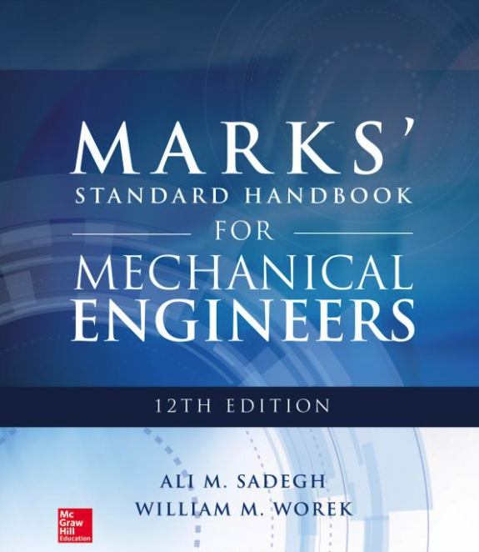
Tackle unfamiliar terminology & topics
UM Library has 10,000+ engineering ebooks available online
Suggested ebook for all ME topics: Marks’ Standard Handbook for Mechanical Engineers 12th edition
Many even allow you to download (and keep!) book chapters or the whole book!
“
“Clear, concise answers to thousands of ME questions. You get accurate data and calculations along with easy-to-understand explanations of current principles, standards, and practices and important codes.”
Notes:
PUT LINK IN CHAT: Marks’ Standard Handbook for Mechanical Engineers https://search.lib.umich.edu/catalog/record/016795103

Slide 35
Tackle unfamiliar terminology & topics
Collections of ebooks:
AccessEngineering: McGraw-Hill Engineering Handbooks
Knovel: Handbooks from various publishers + look up equations and substance properties
American Society of Mechanical Engineers: ASME Digital Collection
Allows you to browse ebooks by topic or search within many ebooks simultaneously
Notes:
Search: fluid kinematics

Slide 36
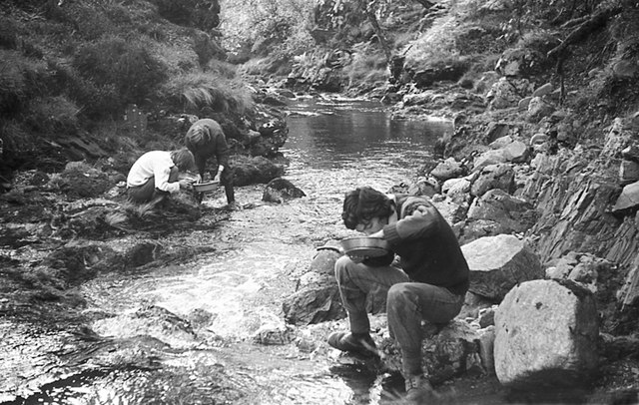
Searching scholarly databases effectively for literature
It’s like panning for gold… You have to sift through a lot of rocks to find a gold nugget

Slide 37
Answer in chat:
Which scholarly databases have you searched in the past?
Why?

Slide 38
Pretend that you’re doing a literature review for a journal article on a new computer vision method you’ve developed to detect failures in 3D printing

Slide 39
U-M Library has 146 databases related to engineering, including 43 related to ME.
How do I know which one to pick?

Slide 40
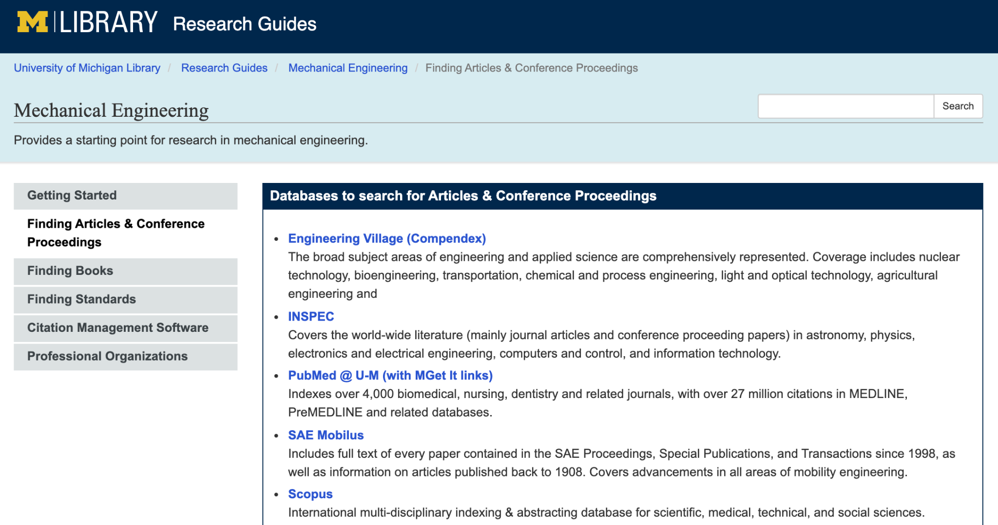
While there is overlap, each database contains unique documents and has a different search algorithm (i.e. order of search results will differ)
Start with databases on ME research guide
General rule:
You’ll need to regularly search multiple databases, especially for interdisciplinary research
(Screenshot is clickable)
Notes:
PUT IT CHAT: ME research guide https://guides.lib.umich.edu/mecheng

Slide 41
Scholarly database | Disciplines covered
Engineering Index (Compendex) | Engineering
INSPEC | Electronics, computer science, physics, mathematics
PubMed | Medical and biomedical fields
SAE Mobilus | Mobility / transportation engineering
Scopus | Engineering, science, medicine, social sciences
Can be searched simultaneously on Engineering Village platform

Slide 42

Strategies to search more efficiently

Slide 43
Break your topic into important concepts
Brainstorm keywords & synonyms for each concept, including broader/narrower terms
3D printing | Failure | Computer vision
Additive manufacturing | Failure detection | Optical monitoring
Three dimensional printing | Error detection
Three-dimensional printing | Fault diagnosis
 | Quality assurance
Different authors use different words to describe the same topic!

Slide 44
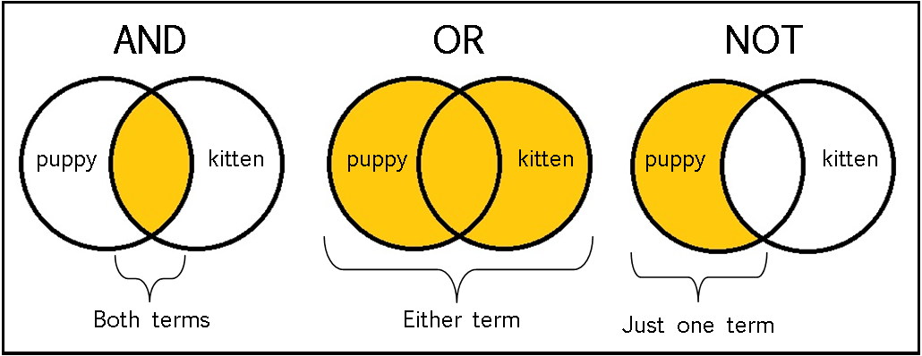
Use Boolean operators to combine keywords
Phrase searching: use “ ” to search for an exact phrase
“computer vision”
Notes:
In EV, { } are the same as “ “

Slide 45
Truncation: use * at end of word to search for all forms
fail* = fail, fails, failure, failures, failing...
Use ( ) to combine different search strategies
fail* AND “computer vision” AND (3D printing OR three dimensional printing OR additive manufacturing)

Slide 46
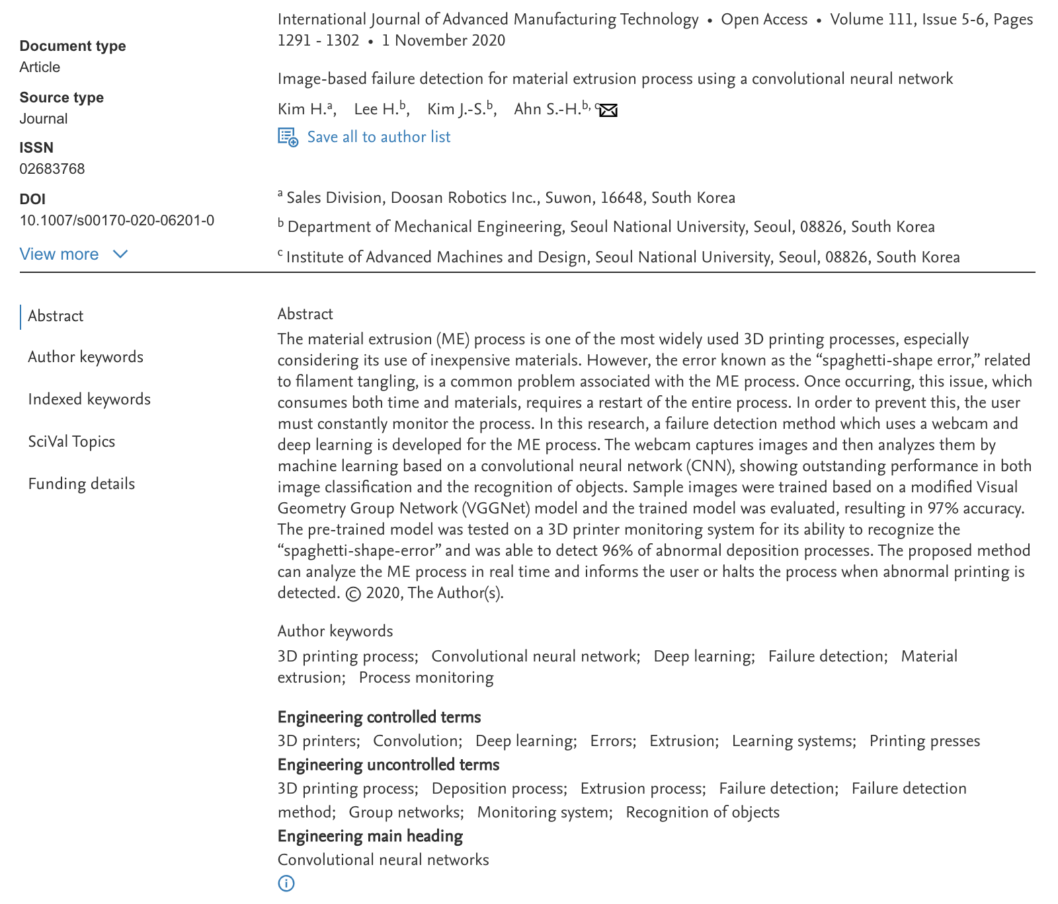
Many scholarly databases have a controlled vocabulary, a standardized language of topics.
If authors use different terms (i.e. uncontrolled vocabulary), the articles will still have the same controlled vocabulary.
Controlled vocabulary words are excellent keywords to use!
Controlled vocabulary in Scopus

Slide 47
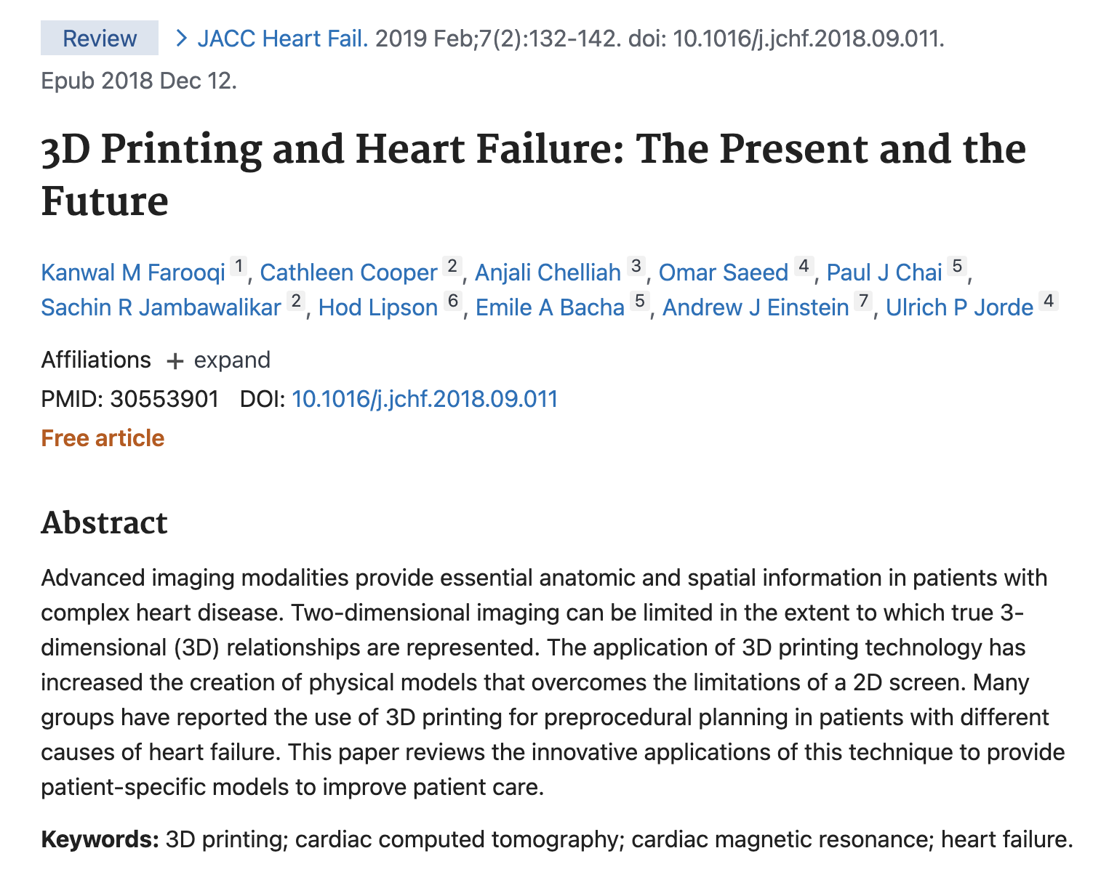
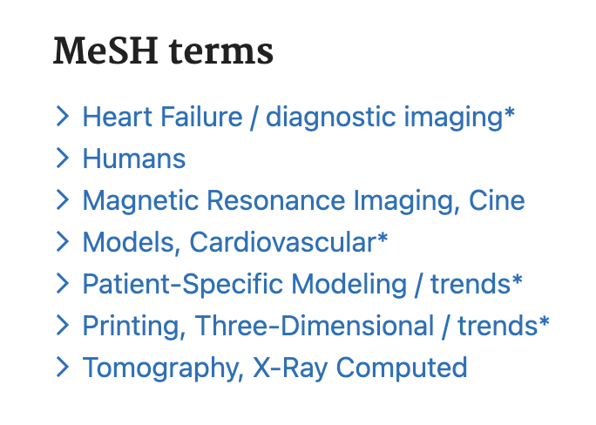
Scroll down to see controlled vocabulary (MeSH terms) in PubMed

Slide 48
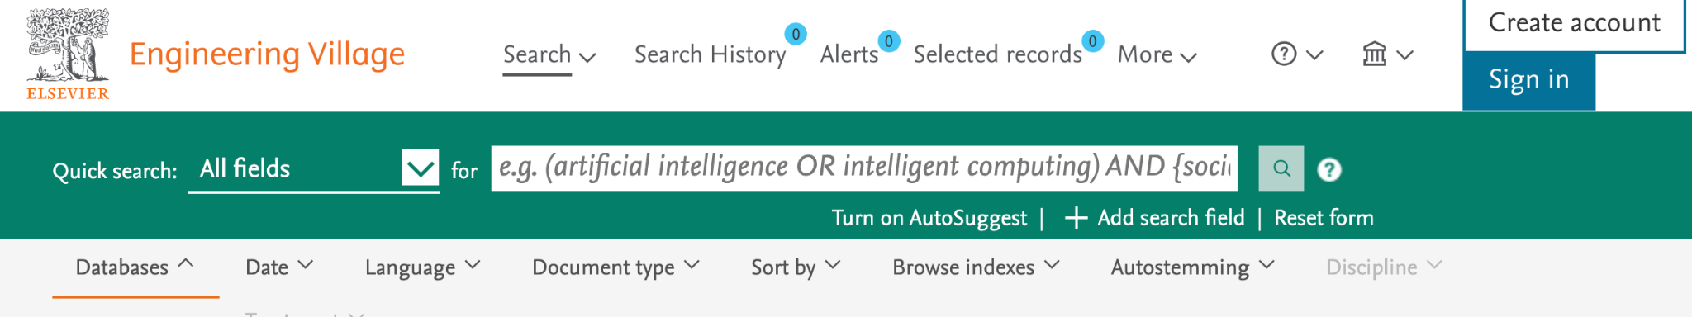
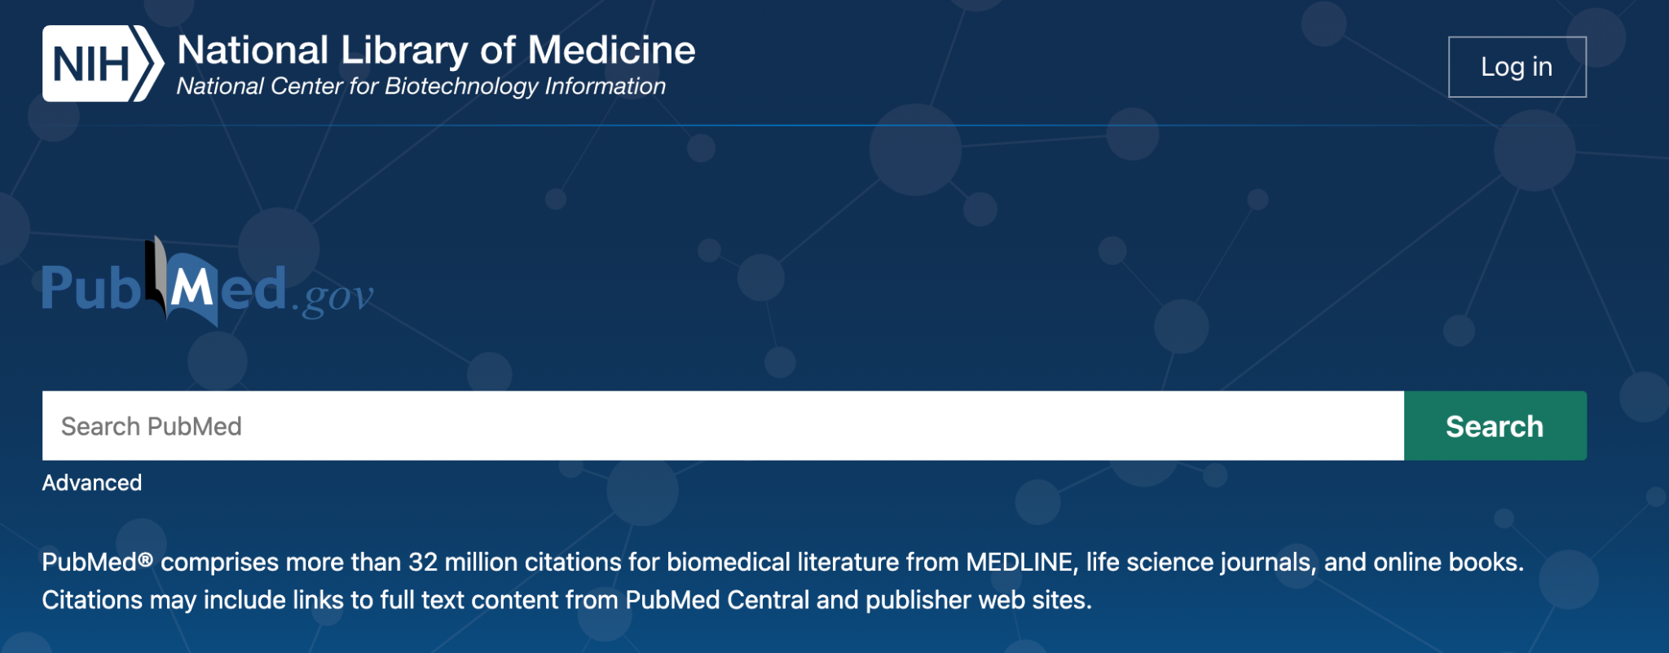
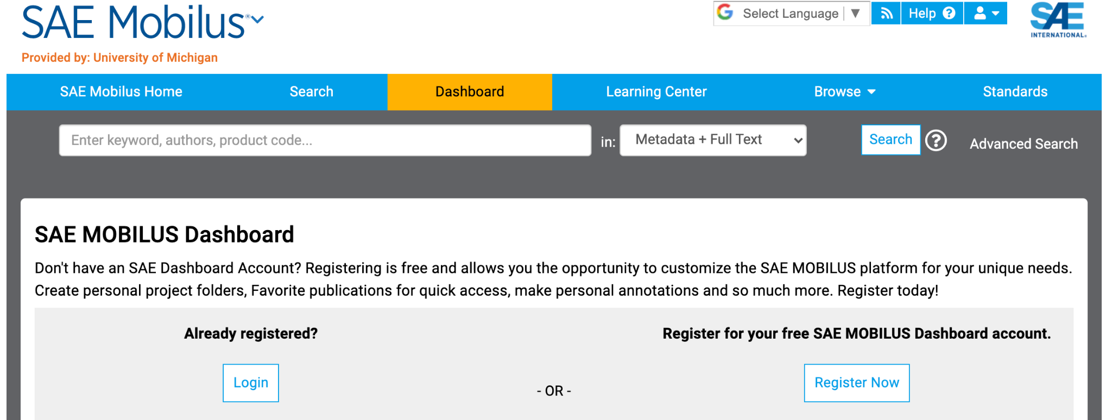
Create a personal account (using UM email) in each scholarly database to 1) save searches and 2) set up alerts

Slide 49
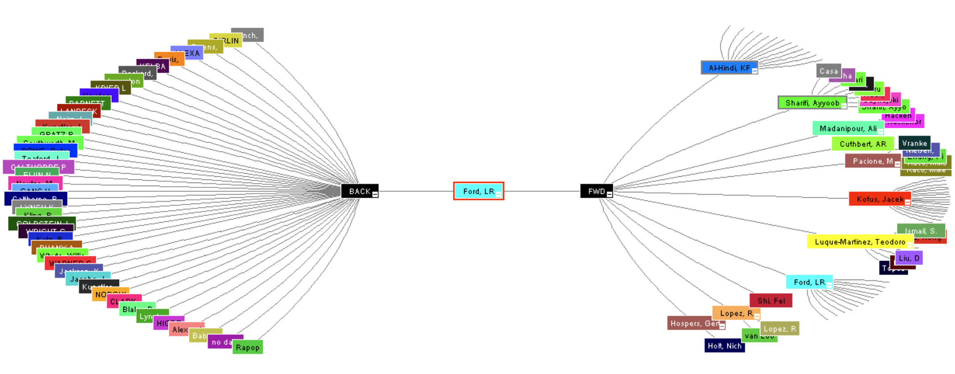
Citation Mapping
Really great ‘seed’ article
Backward in time
Forward in time

Slide 50
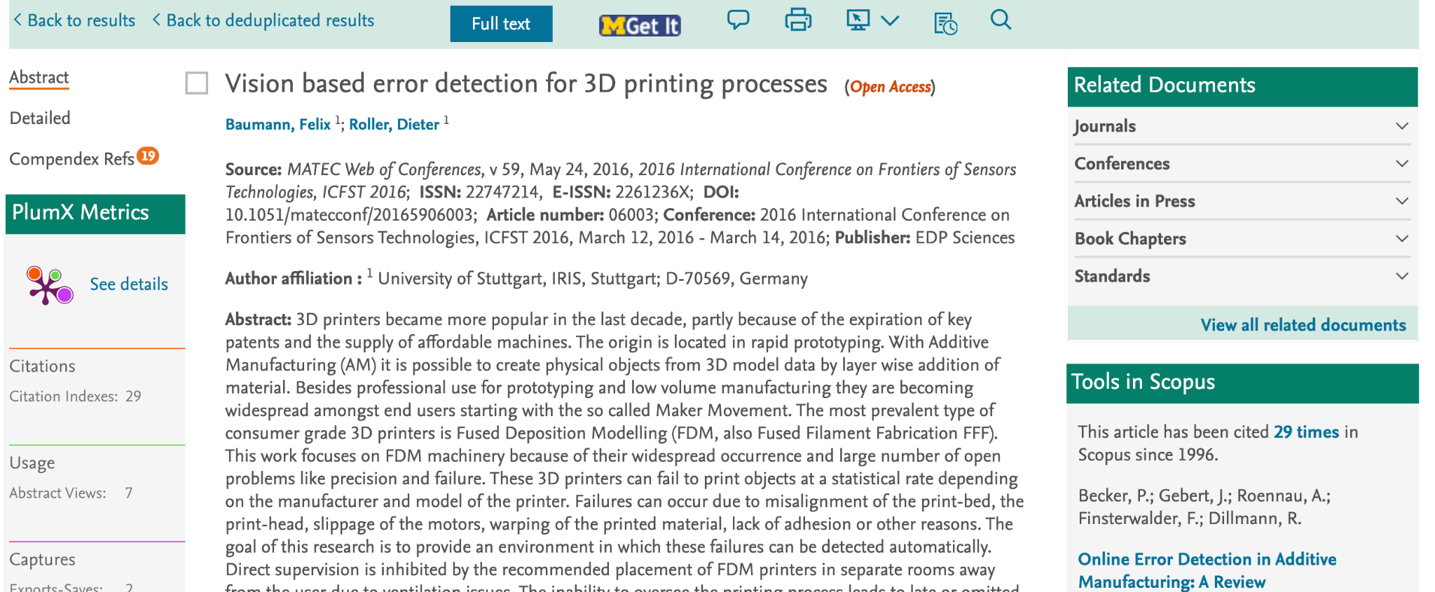
References = move backward in time
Citing docs = move forward in time

Slide 51

Live demo of Scopus

Slide 52

Utilize a citation manager to keep your literature organized

Slide 53
Answer in chat:
Which citation manager do you use? Why?
If you don’t use one, which ones have you heard of?

Slide 54
What is a Citation Manager?
Which citation manager do your lab mates/PI use?
Organize references, PDFs, images
Take notes on references + PDFs
Format Bibliographies/Works Cited pages
Share references + collaborate on projects

Slide 55




Slide 56
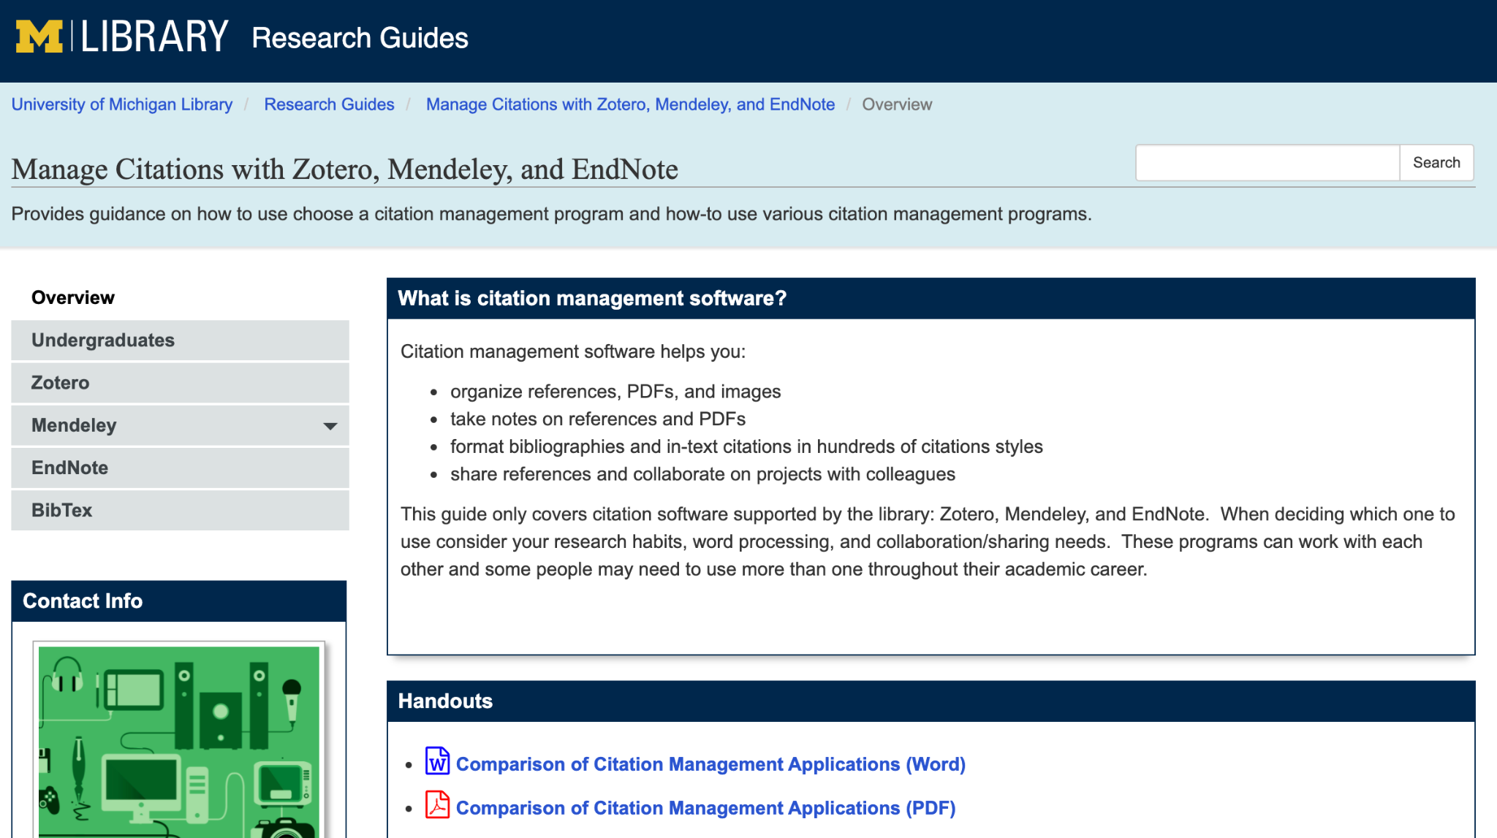
Use this guide to help determine which citation manager best fits YOUR needs
Manage Citations research guide on U-M Library website (screenshot is clickable link)
Notes:
PUT IN CHAT: Guide to help you determine which citation manager to use https://guides.lib.umich.edu/citationmanagementoptions

Slide 57
Live demo of Zotero
Add articles
Upload PDFs
Annotate
Cite and write in Google Docs

Slide 58

Key Takeaways & Additional Resources

Slide 59
Key Takeaways
Break searching into manageable chunks
Get yourself organized early → keep a literature notebook, including keywords
It’s a cyclical process → something you’ll need to do throughout your program

Slide 60
Key Takeaways
New literature is being published daily → you’ll need to continually be looking at it
Use personal account to set up alerts and save searches
The more you search, the easier it will become

Slide 61
Additional Resources
Introduction to Engineering Research by Wendy Crone Chapter 4: Building on the Research of Others
Conducting Your Literature Review by Susanne Hempel
Self-paced, online modules on related topics
Academic Integrity & Plagiarism

Slide 62
Questions?
Joanna Thielen | Librarian for the ME dept.
jethiele@umich.edu
Thanks to Jamie Niehof for letting me use some of her slides

